Slide 1
Amazon
Sales Data Analysis

Slide 2
Objective
Problem Statement
Due to growing competition and the demand for more efficient distribution strategies that lower costs and boost profits, sales management has become more and more important. These days, the most crucial role in a business or commercial enterprise is sales management.
Create a report by extracting, transforming, and loading data that shows the sales trend by year, month, and quarter. You can also identify certain relationships in the data to help you comprehend and analyze the facts.

Slide 3
Amazon.com, Inc., doing business as Amazon, is an American multinational technology company, engaged in e-commerce, cloud computing, online advertising, digital streaming, and artificial intelligence.
Amazon Business Model
Amazon’s business model is multi-faceted, designed to create multiple revenue streams and ensure sustained growth.
Headquarters: Seattle, WA
Founder(s): Jeff Bezos
Founded: 1994
Employees: 1,525,000
Parent organization: Amazon (company)
Competitors: Alibaba, Walmart, Microsoft, Google, Netflix, Disney+, Shopify

Slide 4
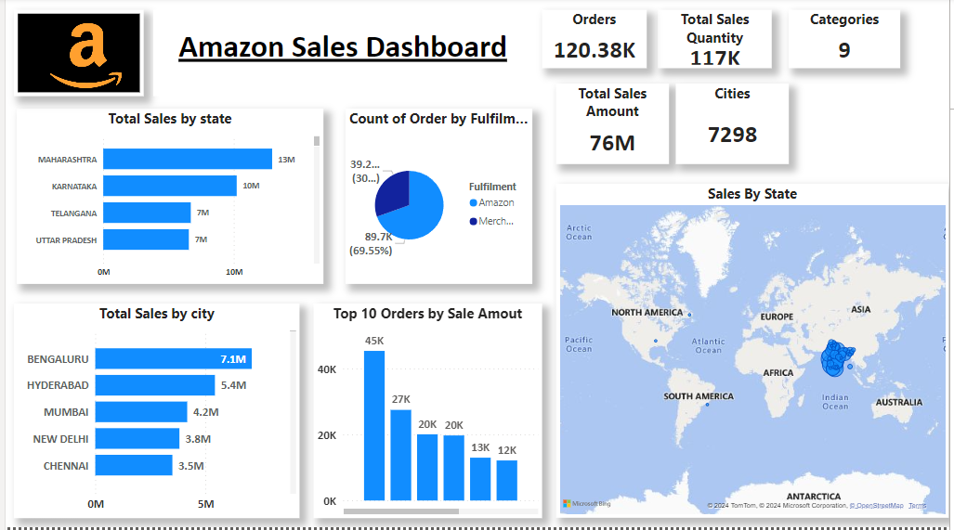

Slide 5
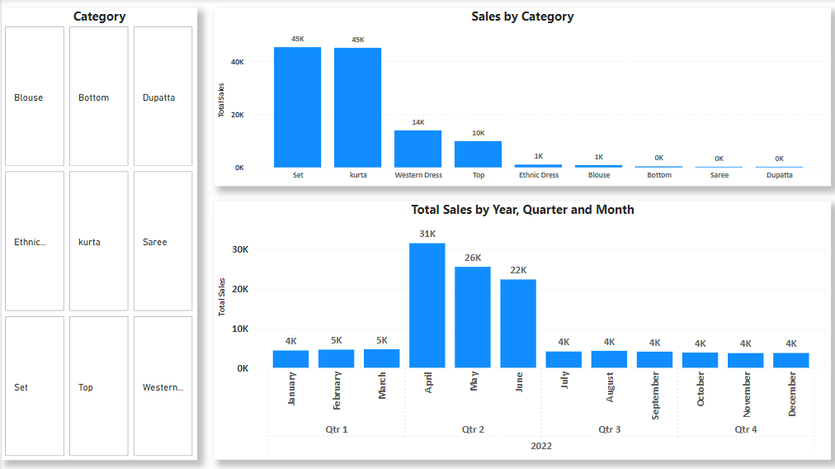

Slide 6
Conclusion
1. April had the highest Revenue at 31K, followed by May at 26K and June at 22k.
2. If we observe the monthly insights of 2022, the sales are at their peak in April, May and June and
are low in October, November & December. Amazon can come up with some good
discounts and offers to generate high revenue.
3. The sales for Maharashtra, Karnataka, Telangana are highest among all States and lowest in Rajasthan.
4. The Set , Kurta & Western Dresses are the highest selling products.
5.Highest order value is 45k followed by 27k and 20k.

Slide 7


